Slide 1
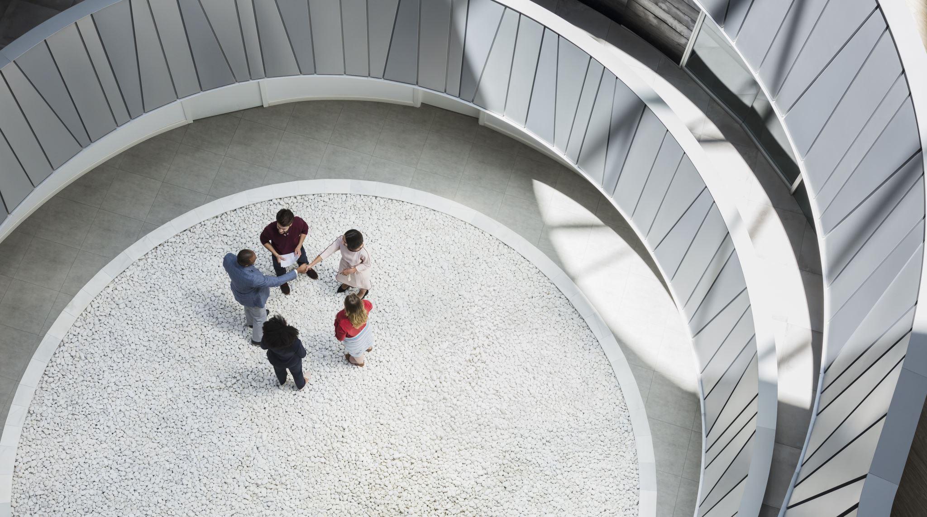
SMART CAMPUS

Slide 2
CONTENTS
Team Details
Abstract
Network Layout
Type Of Network Used
Topology Overview
Module Description
Implementation
Result
References

Slide 3
Team Details
UTKARSH SRIVASTAVA [RA2111026010277]
HARISH G [RA2111026010284]
ANANDKRISHNA V [RA2111026010285]
NILAY KALE [RA2111026010287]
TANMAY GUPTA [RA2111026010288]

Slide 4
ABSTRACT
A smart campus is a simulated environment that uses IoT devices and systems to improve the quality of life and safety on university campuses. It's a complex and interconnected system that requires advanced network topology and IoT architecture.
In a smart campus simulation, multiple networks are used, including school and apartment networks, as well as a dedicated IoT network. One of the key features of a smart campus is RFID access control management. It's commonly used in security and access control systems.
Another important aspect of a smart campus simulation is the integration of intelligent sports field irrigation solutions. These solutions use IoT sensors and data analytics to optimize water usage and improve the health of campus lawns and green spaces. By monitoring weather patterns, soil moisture levels, and other environmental factors, the irrigation system can adjust water usage in real-time, reducing waste and ensuring that campus grounds remain healthy and vibrant.
Overall, a smart campus simulation is an excellent way to demonstrate the complex interconnectivity of IoT devices and systems. By incorporating advanced network topology and IoT architecture, universities can create a safer, more efficient, and more sustainable environment for students, faculty, and staff.

Slide 5
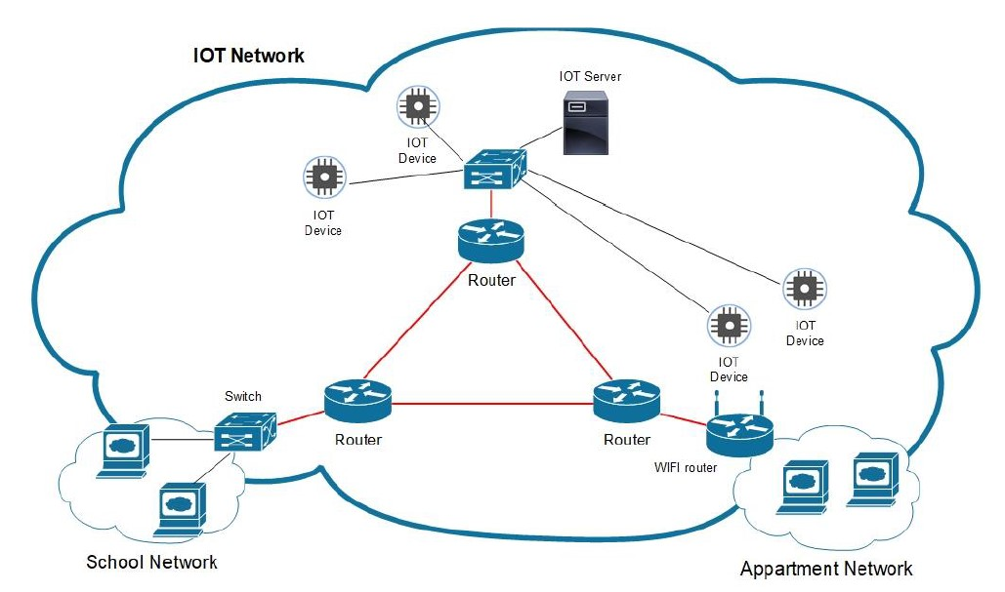
Network layout
The network layout :
Backbone router network
Traditional switch-based classroom wired network
Wireless LAN for the apartment buildings
Dedicated IoT network based also on switch

Slide 6
Network Used
Network used in Smart Campus Project is LAN.
"LAN" stands for "Local Area Network". It is a type of computer network that is confined to a relatively small geographical area, such as a building or a campus. LANs are commonly used in homes, schools, and businesses to allow computers and other devices to communicate and share resources, such as files and printers.
A LAN can be wired or wireless, and can use a variety of technologies such as Ethernet, Wi-Fi, and Bluetooth. In a wired LAN, devices are connected to a central hub or switch using Ethernet cables. In a wireless LAN, devices communicate with each other using radio waves over Wi-Fi.
LANs typically offer high-speed data transfer rates, low latency, and the ability to share resources within the network. They are also relatively easy to set up and maintain, and can be secured with various types of security protocols to protect against unauthorized access.
Overall, LANs are an essential component of modern computer networks, enabling communication and collaboration between devices within a local area.

Slide 7
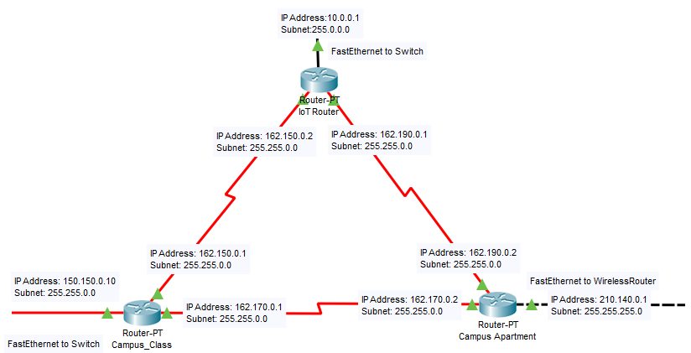
Module description - module 1
In this scenario, three routers are being used in a network and they are interconnected using Serial DTE (Data Terminal Equipment) connections.
The use of three routers in this network allows for a more complex and robust network topology, which can provide greater scalability, reliability, and redundancy. By interconnecting the routers using serial DTE connections, the network can be designed to provide a higher level of performance and efficiency
Backbone Router Network

Slide 8
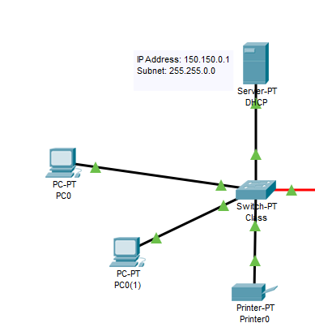
Module 2
Here, we're using a switch to link router campus class to different pcs, one printer, and one DHCP server.
The DHCP server will ensure that each device has a unique IP address, and Router campus class will provide a connection to the internet or other external networks. The switch will provide a central point for communication between all of the devices in the network.
Campus Class Network

Slide 9
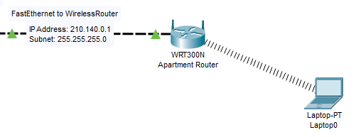
Module 3
Deploying the wireless router in place, a wireless network is set up using the WRT300N so that different devices may connect to it.
Campus Apartment Network

Slide 10
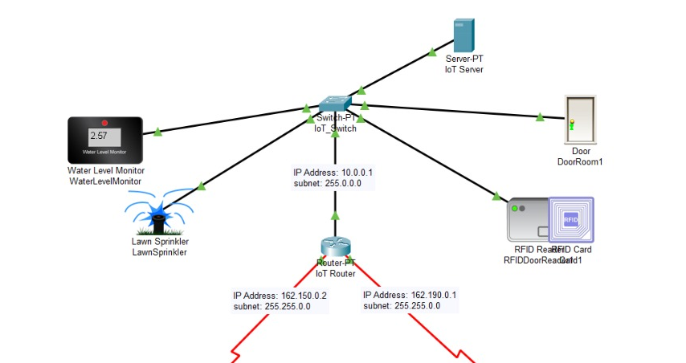
Module 4
Setting up the IoT devices
All the devices will be registered in the IoT server
If the water level falls below 3cm, the water level monitor activates the sprinkler system.
IoT Network

Slide 11
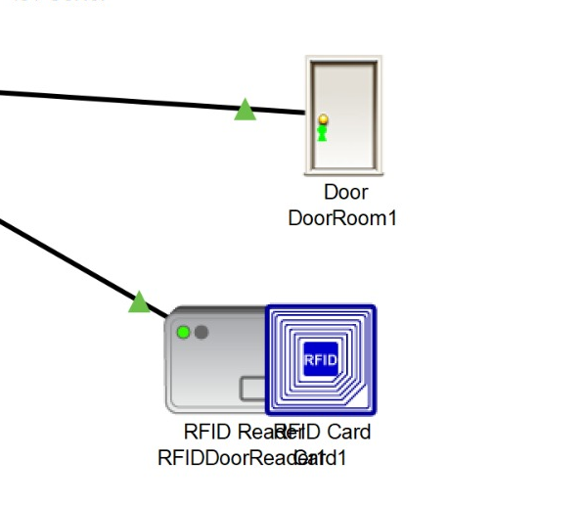
Module 5
Now, we proceed to configure the RFID Reader by adding conditions in the Condition section on the IoT Registration Service website.
The next step was to set all RFID readers into a waiting mode and lock the room doors. This was done for all RFID readers.
Conditions are set for both locking and unlocking doors
The door will unlock with the proper RFID as shown.
RFIDs

Slide 12
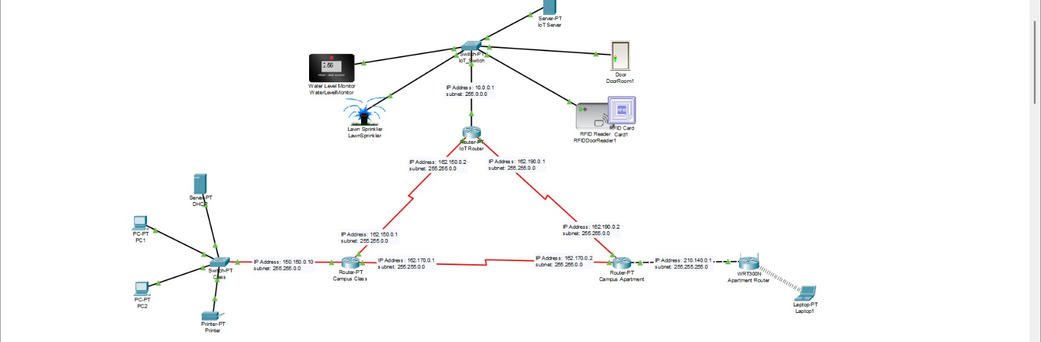
implementation

Slide 13

RESULT
A smart campus uses IoT devices and systems to improve the quality of life and safety on university campuses. It's a complex and interconnected system that requires advanced network topology and IoT architecture. Multiple networks are used, including school and apartment networks, as well as a dedicated IoT network. One of the key features of a smart campus is RFID access control management, which is commonly used in security and access control systems.

Slide 14

REFERENCES
http://solidstatetechnology.us/index.php/jsst/article/view/5269
https://www.ijera.com/papers/vol9no4/Series-3/F0904033439.pdf
https://ijisrt.com/wp-content/uploads/2017/11/Boosting-Campus-Network-Design-Using-Cisco-Packet-Tracer.pdf

Slide 15

THANK-YOU

